Slide 1
BULLETPROOFING YOUR CONTRACTS
Alex Gertsburg, Esq.
Gertsburg Law Firm Co., LPA

Slide 2


We Solve Problems
100 N. Main Street, Suite 300
Chagrin Falls, Ohio 44022
Phone: (440) 571-7777
Fax: (440) 571-7779
www.GertsburgLaw.com
  Follow the conversation on Twitter!
  @bizconcle #bizconcle16

Slide 3
  I. THRESHOLD MATTERS
  Follow the conversation on Twitter!
  @bizconcle #bizconcle16

Slide 4
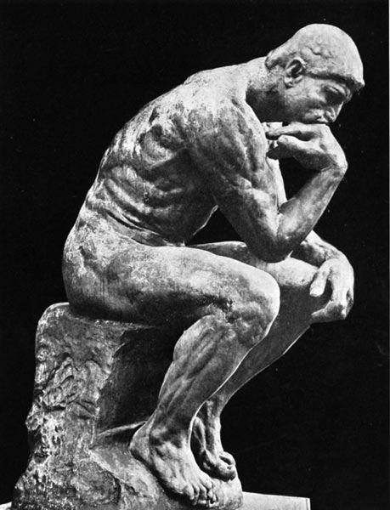
I. THRESHOLD MATTERS
(a) My Philosophy –
Land Grabbing
  Follow the conversation on Twitter!
  @bizconcle #bizconcle16

Slide 5

I. THRESHOLD MATTERS
(b) Leverage –
Size matters
  Follow the conversation on Twitter!
  @bizconcle #bizconcle16

Slide 6

I. THRESHOLD MATTERS
(c) Use correct Names
for the Company and Individual Signing
  Follow the conversation on Twitter!
  @bizconcle #bizconcle16

Slide 7

I. THRESHOLD MATTERS
(d) Non-Specific;
Look at the Competition
  Follow the conversation on Twitter!
  @bizconcle #bizconcle16

Slide 8
  II. CUSTOMER CONTRACTS
  Follow the conversation on Twitter!
  @bizconcle #bizconcle16

Slide 9

II. CUSTOMER CONTRACTS
(a) People Contracts
vs.
Business Contracts
  Follow the conversation on Twitter!
  @bizconcle #bizconcle16

Slide 10
II. CUSTOMER CONTRACTS
(b) No Warranty – “AS IS” – ALL CAPS; Specific Language
  Follow the conversation on Twitter!
  @bizconcle #bizconcle16

Slide 11
II. CUSTOMER CONTRACTS
(c) Remedies
  Limitation of Liability
  No Consequential Damages
  Specific Remedies (e.g. repair or replace)
  Follow the conversation on Twitter!
  @bizconcle #bizconcle16

Slide 12

II. CUSTOMER CONTRACTS
(d) Attorney Fee Provision
  Follow the conversation on Twitter!
  @bizconcle #bizconcle16

Slide 13

II. CUSTOMER CONTRACTS
(e) Acceptable Use
  Follow the conversation on Twitter!
  @bizconcle #bizconcle16

Slide 14

II. CUSTOMER CONTRACTS
(f) Force Majeure
  Follow the conversation on Twitter!
  @bizconcle #bizconcle16

Slide 15
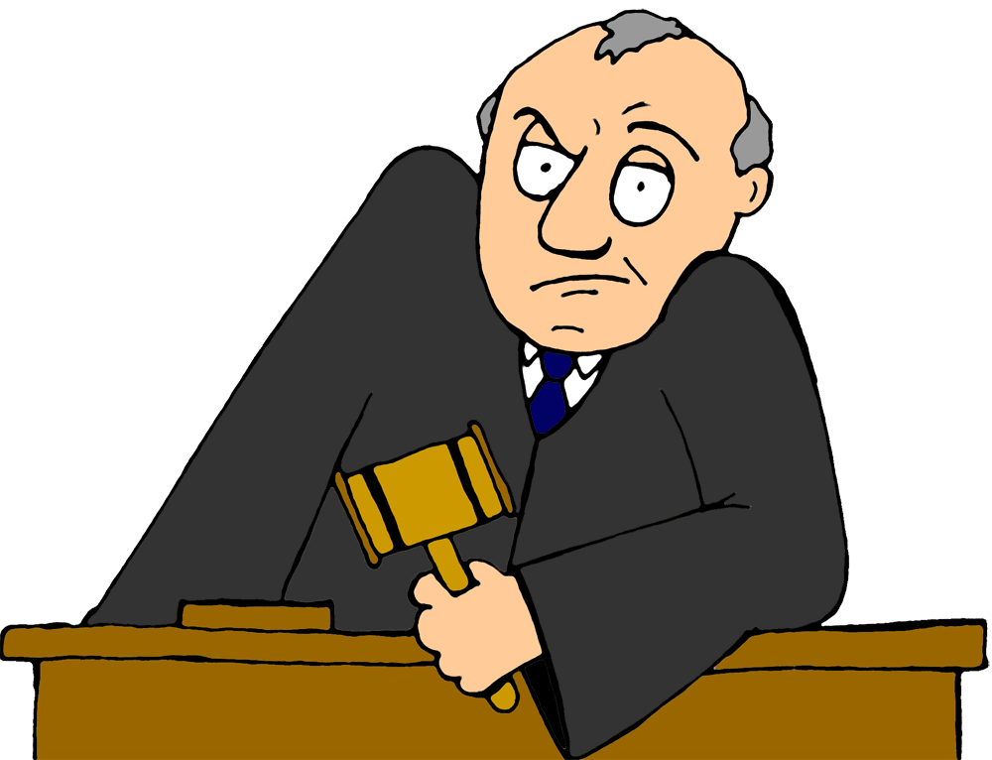
II. CUSTOMER CONTRACTS
Jury Waiver
  Follow the conversation on Twitter!
  @bizconcle #bizconcle16

Slide 16
II. CUSTOMER CONTRACTS
No Class Actions
  Follow the conversation on Twitter!
  @bizconcle #bizconcle16

Slide 17
  III. PURCHASING AGREEMENTS
  Follow the conversation on Twitter!
  @bizconcle #bizconcle16

Slide 18

III. PURCHASING AGREEMENTS
Warranty Language
  Follow the conversation on Twitter!
  @bizconcle #bizconcle16

Slide 19

III. PURCHASING AGREEMENTS
Delivery Dates
  Follow the conversation on Twitter!
  @bizconcle #bizconcle16

Slide 20

III. PURCHASING AGREEMENTS
Performance Measures
  Follow the conversation on Twitter!
  @bizconcle #bizconcle16

Slide 21
III. PURCHASING AGREEMENTS
Attorney Fee Provision
  Follow the conversation on Twitter!
  @bizconcle #bizconcle16

Slide 22
III. PURCHASING AGREEMENTS
Remedies for Default
  Follow the conversation on Twitter!
  @bizconcle #bizconcle16

Slide 23

III. PURCHASING AGREEMENTS
Indemnification
  Follow the conversation on Twitter!
  @bizconcle #bizconcle16

Slide 24
  IV. TERMS APPLICABLE TO ALL CONTRACTS
  Follow the conversation on Twitter!
  @bizconcle #bizconcle16

Slide 25

IV. TERMS APPLICABLE TO ALL CONTRACTS
Dispute Resolution
  AAA vs. Court
  Forum Selection
  Choice of Law
  Follow the conversation on Twitter!
  @bizconcle #bizconcle16

Slide 26
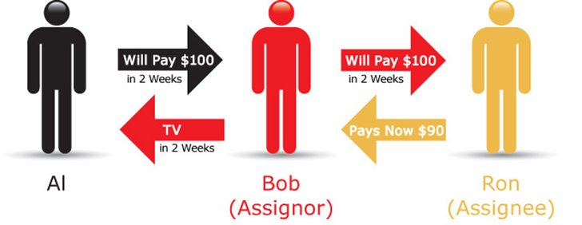
IV. TERMS APPLICABLE TO ALL CONTRACTS
Assignment Language
  Follow the conversation on Twitter!
  @bizconcle #bizconcle16

Slide 27

IV. TERMS APPLICABLE TO ALL CONTRACTS
Construction
of Contracts
  Follow the conversation on Twitter!
  @bizconcle #bizconcle16

Slide 28
  V. SPECIAL CONTRACTS
  Follow the conversation on Twitter!
  @bizconcle #bizconcle16

Slide 29

V. SPECIAL CONTRACTS
Non-Disclosure Agreements (NDA)
  Follow the conversation on Twitter!
  @bizconcle #bizconcle16

Slide 30

V. SPECIAL CONTRACTS
Attorney Agreements
  Follow the conversation on Twitter!
  @bizconcle #bizconcle16

Slide 31
QUESTIONS?
Please take a moment to complete your
workshop survey in the convention app

